Slide 1
CNN Intuition and working
Dr. Sagarika B

Slide 2
Recap: Session 1,2,3
ANN Training
Forward propagation
Back propagation
ANN performance improvement
Vanishing Gradient problem
Under fitting
Overfitting
SLow training
Hyper parameter tuning
Activation function
Model architecture
Weight initialization
Regularization
Optimizers
Learning rate

Slide 3
Agenda: Session 4
Basic image representations
Image filtering operations
Issues faced by ANN
CNN intro
Layers in CNN
How learning happens in CNN?

Slide 4
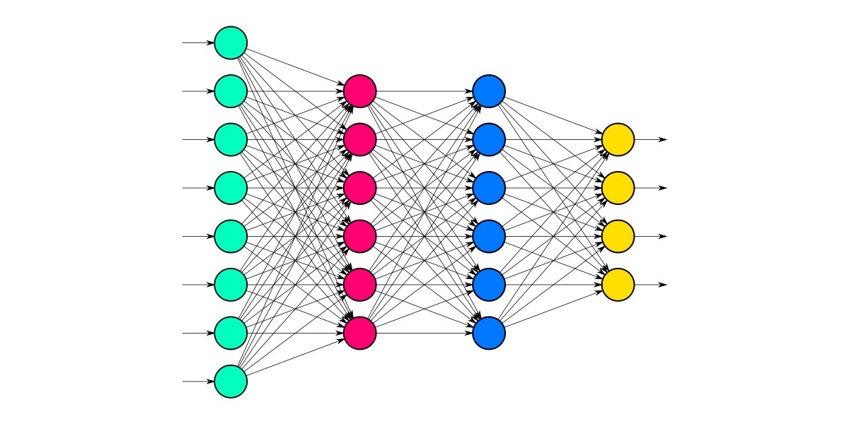
What are the problems in ANN ?
What is a Dense layer ?
Input layer
Hidden layer
Output layer
Which one is Dense layer ?

Slide 5
Limitations of a dense layer !!
More number of Number of weights and biases leads to overfitting
This mostly happens in images (every pixel as an input)

Slide 6
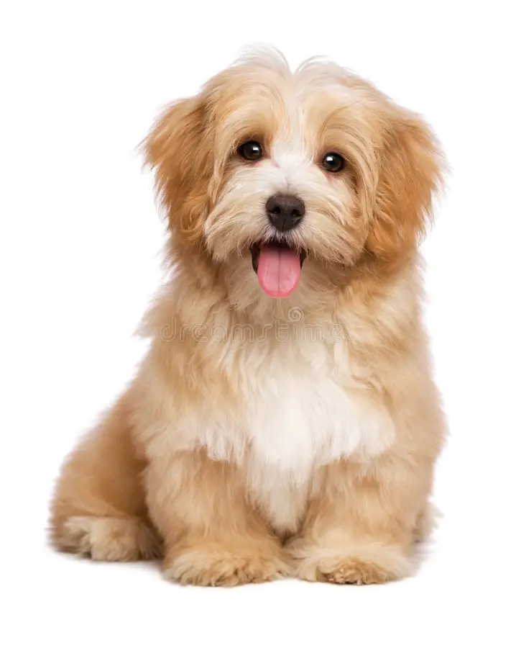
Spatial info is lost (Neighborhood information)
Nose !!
Not Nose !!

Slide 7
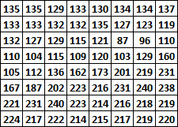




……

Slide 8
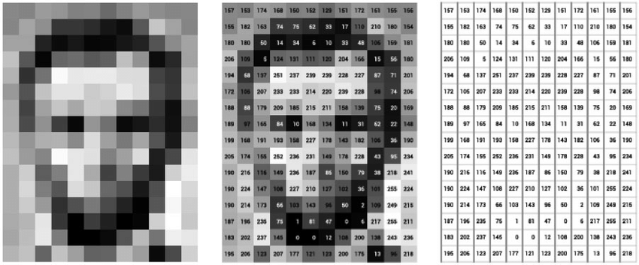
One solution could be to Reduce the image resolution !!
This may lead to underfitting !!

Slide 9
How to solve these problems !!
Convolutional Layers
Reduce the number of weights and biases
Neighborhood information is captured !!

Slide 10
Look at the image part by part !!

Slide 11
Convolution Operation
Convolve = Sliding window !!

Slide 12
kernel
filter
2 | 4 | 5 | 6 | 2 | 3
3 | 1 | 2 | 3 | 5 | 7
2 | 3 | 1 | 3 | 6 | 0
7 | 7 | 8 | 4 | 6 | 2
8 | 4 | 6 | 9 | 4 | 8
3 | 4 | 6 | 8 | 10 | 4
1 | 2 | 1
0 | 0 | 0
1 | 2 | 1
 | 23
=(1x2)+(2x4)+(5x1)+(3x0)+(1x0)+(2x0)+(2x1)+(3x2)+(1x1)
=23

Slide 13
kernel
filter
2 | 4 | 5 | 6 | 2 | 3
3 | 1 | 2 | 3 | 5 | 7
2 | 3 | 1 | 3 | 6 | 0
7 | 7 | 8 | 4 | 6 | 2
8 | 4 | 6 | 9 | 4 | 8
3 | 4 | 6 | 8 | 10 | 4
1 | 2 | 1
0 | 0 | 0
1 | 2 | 1
 | 23 | 28
=(1x4)+(2x5)+(6x1)+(1x0)+(2x0)+(3x0)+(3x1)+(1x2)+(3x1)
=28

Slide 14
kernel
filter
2 | 4 | 5 | 6 | 2 | 3
3 | 1 | 2 | 3 | 5 | 7
2 | 3 | 1 | 3 | 6 | 0
7 | 7 | 8 | 4 | 6 | 2
8 | 4 | 6 | 9 | 4 | 8
3 | 4 | 6 | 8 | 10 | 4
1 | 2 | 1
0 | 0 | 0
1 | 2 | 1
 | 23 | 28 | 32
=(1x5)+(2x6)+(2x1)+(2x0)+(3x0)+(5x0)+(1x1)+(3x2)+(6x1)
=32

Slide 15
kernel
filter
2 | 4 | 5 | 6 | 2 | 3
3 | 1 | 2 | 3 | 5 | 7
2 | 3 | 1 | 3 | 6 | 0
7 | 7 | 8 | 4 | 6 | 2
8 | 4 | 6 | 9 | 4 | 8
3 | 4 | 6 | 8 | 10 | 4
1 | 2 | 1
0 | 0 | 0
1 | 2 | 1
 | 23 | 28 | 32 | 28
=(1x6)+(2x2)+(3x1)+(3x0)+(1x0)+(2x0)+(3x1)+(6x2)+(0x1)
=28

Slide 16
kernel
filter
2 | 4 | 5 | 6 | 2 | 3
3 | 1 | 2 | 3 | 5 | 7
2 | 3 | 1 | 3 | 6 | 0
7 | 7 | 8 | 4 | 6 | 2
8 | 4 | 6 | 9 | 4 | 8
3 | 4 | 6 | 8 | 10 | 4
1 | 2 | 1
0 | 0 | 0
1 | 2 | 1
 | 23 | 28 | 32 | 28
 | 36
=(1x3)+(2x1)+(2x1)+(2x0)+(3x0)+(1x0)+(7x1)+(7x2)+(8x1)
=36

Slide 17
kernel
filter
2 | 4 | 5 | 6 | 2 | 3
3 | 1 | 2 | 3 | 5 | 7
2 | 3 | 1 | 3 | 6 | 0
7 | 7 | 8 | 4 | 6 | 2
8 | 4 | 6 | 9 | 4 | 8
3 | 4 | 6 | 8 | 10 | 4
1 | 2 | 1
0 | 0 | 0
1 | 2 | 1
 | 23 | 28 | 32 | 28
 | 36 | 35
=(1x1)+(2x2)+(3x1)+(3x0)+(1x0)+(2x0)+(7x1)+(8x2)+(4x1)
=35

Slide 18
kernel
filter
2 | 4 | 5 | 6 | 2 | 3
3 | 1 | 2 | 3 | 5 | 7
2 | 3 | 1 | 3 | 6 | 0
7 | 7 | 8 | 4 | 6 | 2
8 | 4 | 6 | 9 | 4 | 8
3 | 4 | 6 | 8 | 10 | 4
1 | 2 | 1
0 | 0 | 0
1 | 2 | 1
 | 23 | 28 | 32 | 28
 | 36 | 35 | 35
=(1x2)+(2x3)+(5x1)+(1x0)+(3x0)+(6x0)+(8x1)+(4x2)+(6x1)
=35

Slide 19
kernel
filter
2 | 4 | 5 | 6 | 2 | 3
3 | 1 | 2 | 3 | 5 | 7
2 | 3 | 1 | 3 | 6 | 0
7 | 7 | 8 | 4 | 6 | 2
8 | 4 | 6 | 9 | 4 | 8
3 | 4 | 6 | 8 | 10 | 4
1 | 2 | 1
0 | 0 | 0
1 | 2 | 1
 | 23 | 28 | 32 | 28
 | 36 | 35 | 35 | 36
=(1x3)+(2x4)+(7x1)+(3x0)+(6x0)+(0x0)+(4x1)+(6x2)+(2x1)
=36

Slide 20
kernel
filter
2 | 4 | 5 | 6 | 2 | 3
3 | 1 | 2 | 3 | 5 | 7
2 | 3 | 1 | 3 | 6 | 0
7 | 7 | 8 | 4 | 6 | 2
8 | 4 | 6 | 9 | 4 | 8
3 | 4 | 6 | 8 | 10 | 4
1 | 2 | 1
0 | 0 | 0
1 | 2 | 1
 | 23 | 28 | 32 | 28
 | 36 | 35 | 35 | 36
=(1x3)+(2x4)+(7x1)+(3x0)+(6x0)+(0x0)+(4x1)+(6x2)+(2x1)
=36

Slide 21
kernel
filter
2 | 4 | 5 | 6 | 2 | 3
3 | 1 | 2 | 3 | 5 | 7
2 | 3 | 1 | 3 | 6 | 0
7 | 7 | 8 | 4 | 6 | 2
8 | 4 | 6 | 9 | 4 | 8
3 | 4 | 6 | 8 | 10 | 4
1 | 2 | 1
0 | 0 | 0
1 | 2 | 1
 | 23 | 28 | 32 | 28
 | 36 | 35 | 35 | 36
 | 31
=(1x2)+(2x3)+(1x1)+(7x0)+(7x0)+(8x0)+(8x1)+(4x2)+(6x1)
=31

Slide 22
kernel
filter
2 | 4 | 5 | 6 | 2 | 3
3 | 1 | 2 | 3 | 5 | 7
2 | 3 | 1 | 3 | 6 | 0
7 | 7 | 8 | 4 | 6 | 2
8 | 4 | 6 | 9 | 4 | 8
3 | 4 | 6 | 8 | 10 | 4
1 | 2 | 1
0 | 0 | 0
1 | 2 | 1
 | 23 | 28 | 32 | 28
 | 36 | 35 | 35 | 36
 | 31 | 33
=(1x3)+(2x1)+(3x1)+(7x0)+(8x0)+(4x0)+(4x1)+(6x2)+(9x1)
=33

Slide 23
kernel
filter
2 | 4 | 5 | 6 | 2 | 3
3 | 1 | 2 | 3 | 5 | 7
2 | 3 | 1 | 3 | 6 | 0
7 | 7 | 8 | 4 | 6 | 2
8 | 4 | 6 | 9 | 4 | 8
3 | 4 | 6 | 8 | 10 | 4
1 | 2 | 1
0 | 0 | 0
1 | 2 | 1
 | 23 | 28 | 32 | 28
 | 36 | 35 | 35 | 36
 | 31 | 33 | 33
=(1x1)+(2x3)+(6x1)+(8x0)+(4x0)+(6x0)+(6x1)+(9x2)+(4x1)
=33

Slide 24
kernel
filter
2 | 4 | 5 | 6 | 2 | 3
3 | 1 | 2 | 3 | 5 | 7
2 | 3 | 1 | 3 | 6 | 0
7 | 7 | 8 | 4 | 6 | 2
8 | 4 | 6 | 9 | 4 | 8
3 | 4 | 6 | 8 | 10 | 4
1 | 2 | 1
0 | 0 | 0
1 | 2 | 1
 | 23 | 28 | 32 | 28
 | 36 | 35 | 35 | 36
 | 31 | 33 | 33 | 41
=(1x3)+(2x6)+(0x1)+(4x0)+(6x0)+(2x0)+(9x1)+(4x2)+(8x1)
=41

Slide 25
filter
2 | 4 | 5 | 6 | 2 | 3
3 | 1 | 2 | 3 | 5 | 7
2 | 3 | 1 | 3 | 6 | 0
7 | 7 | 8 | 4 | 6 | 2
8 | 4 | 6 | 9 | 4 | 8
3 | 4 | 6 | 8 | 10 | 4
1 | 2 | 1
0 | 0 | 0
1 | 2 | 1
 | 23 | 28 | 32 | 28
 | 36 | 35 | 35 | 36
 | 31 | 33 | 33 | 41
 | 44
kernel
=(1x7)+(2x7)+(8x1)+(8x0)+(4x0)+(6x0)+(3x1)+(4x2)+(6x1)
=44

Slide 26
filter
2 | 4 | 5 | 6 | 2 | 3
3 | 1 | 2 | 3 | 5 | 7
2 | 3 | 1 | 3 | 6 | 0
7 | 7 | 8 | 4 | 6 | 2
8 | 4 | 6 | 9 | 4 | 8
3 | 4 | 6 | 8 | 10 | 4
1 | 2 | 1
0 | 0 | 0
1 | 2 | 1
 | 23 | 28 | 32 | 28
 | 36 | 35 | 35 | 36
 | 31 | 33 | 33 | 41
 | 44 | 51
kernel
=(1x7)+(2x8)+(4x1)+(4x0)+(6x0)+(9x0)+(4x1)+(6x2)+(1x8)
=51

Slide 27
filter
2 | 4 | 5 | 6 | 2 | 3
3 | 1 | 2 | 3 | 5 | 7
2 | 3 | 1 | 3 | 6 | 0
7 | 7 | 8 | 4 | 6 | 2
8 | 4 | 6 | 9 | 4 | 8
3 | 4 | 6 | 8 | 10 | 4
1 | 2 | 1
0 | 0 | 0
1 | 2 | 1
 | 23 | 28 | 32 | 28
 | 36 | 35 | 35 | 36
 | 31 | 33 | 33 | 41
 | 44 | 51 | 54
kernel
=(1x8)+(2x4)+(6x1)+(6x0)+(9x0)+(4x0)+(6x1)+(8x2)+(10x1)
=54

Slide 28
filter
2 | 4 | 5 | 6 | 2 | 3
3 | 1 | 2 | 3 | 5 | 7
2 | 3 | 1 | 3 | 6 | 0
7 | 7 | 8 | 4 | 6 | 2
8 | 4 | 6 | 9 | 4 | 8
3 | 4 | 6 | 8 | 10 | 4
1 | 2 | 1
0 | 0 | 0
1 | 2 | 1
 | 23 | 28 | 32 | 28
 | 36 | 35 | 35 | 36
 | 31 | 33 | 33 | 41
 | 44 | 51 | 54 | 50
kernel
Feature map
=(1x4)+(2x6)+(2x1)+(9x0)+(4x0)+(8x0)+(8x1)+(10x2)+(4x1)
=50

Slide 29
Example a kid learning to draw,
He will learn with lines, curves……

Slide 30
What is a filter ?
A filter, or kernel, in a CNN is a small matrix of weights that slides over the input data (such as an image), performs element-wise multiplication with the part of the input it is currently on, and then sums up all the results into a single output pixel.
2 | 4 | 5 | 6 | 2 | 3
3 | 1 | 2 | 3 | 5 | 7
2 | 3 | 1 | 3 | 6 | 0
7 | 7 | 8 | 4 | 6 | 2
8 | 4 | 6 | 9 | 4 | 8
3 | 4 | 6 | 8 | 10 | 4
How many weights to learn ?
9
1 | 2 | 1
0 | 0 | 0
1 | 2 | 1
Filter
3x3
Image
6x6
1 filter = 1 neuron

Slide 31
Size of a filter : Hyperparameter (usually small size)
Sliding the Filter: The filter slides across the input data, moving by a certain number of pixels each time, defined by the “stride”
Feature Extraction: Filters are responsible for feature extraction in CNNs.
For example, some filters might become specialized to detect horizontal edges in an image, others might detect vertical edges, colors, textures, etc.
As the model becomes deeper, the filters can recognize more complex patterns.

Slide 32
I am looking for a feature which looks like this —--
High value in the feature map after convolution means strong presence of the feature.
0 | 0 | 0 | 1 | 0
0 | 0 | 1 | 0 | 0
0 | 1 | 0 | 0 | 0
0 | 1 | 0 | 0 | 0
0 | 0 | 1 | 0 | 0

Slide 33
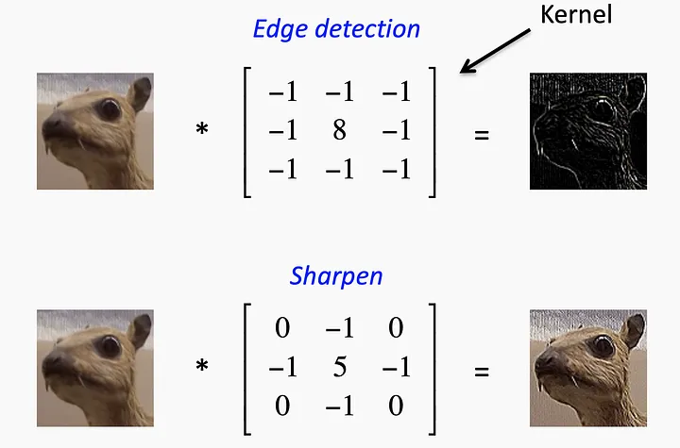

Slide 34
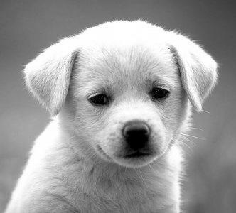
Multiple filters
Multiple feature maps
Feature map
6x6
3x3x3
4x4x3
Filter1
feature map 1
3x3
4x4
feature map 2
Filter2
3x3x3
3x3
4x4
4x4x3
Filter3
feature map 3
6x6x3
3x3
4x4

Slide 35
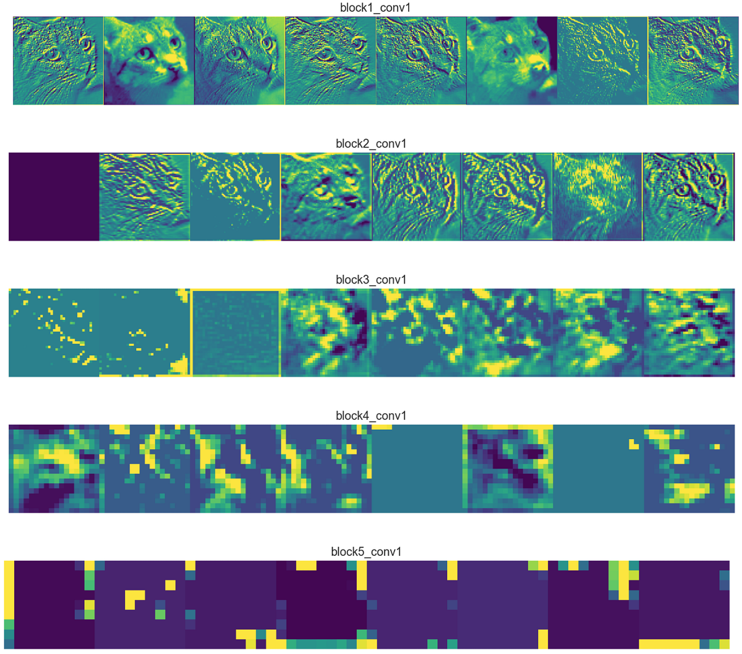
Visualize feature maps

Slide 36
Stride
The number says how many pixels will slide from left to right during convolution.
Stride =(1,1)
Stride value High
Resulting output feature map size decreases
Stride value Low
Output feature map size will be larger.
This can help us to reduce overfitting !!!
2 | 4 | 5 | 6 | 2 | 3
3 | 1 | 2 | 3 | 5 | 7
2 | 3 | 1 | 3 | 6 | 0
7 | 7 | 8 | 4 | 6 | 2
8 | 4 | 6 | 9 | 4 | 8
3 | 4 | 6 | 8 | 10 | 4

Slide 37
FM= (N-F)/S +1
FM= feature map size
N= Image size
F= filter size
S= Stride size
Image size = 7x7
Filter size = 3x3
stride = 1
Output feature map size=
5x5
Image size = 7x7
Filter size = 3x3
stride = 2
Output feature map size=
3x3

Slide 38
Padding
A padding layer is typically added to ensure that the outer boundaries of the input layer doesn’t lose its features when the convolution operation is applied. It is also done to adjust the size of the input
Zero padding
0 | 0 | 0 | 0 | 0 | 0 | 0 | 0 | 0
0 |  |  |  |  |  |  |  | 0
0 |  |  |  |  |  |  |  | 0
0 |  |  |  |  |  |  |  | 0
0 |  |  |  |  |  |  |  | 0
0 |  |  |  |  |  |  |  | 0
0 |  |  |  |  |  |  |  | 0
0 |  |  |  |  |  |  |  | 0
0 | 0 | 0 | 0 | 0 | 0 | 0 | 0 | 0
Image size = 7x7
Filter size = 3x3
stride = 3
Does not fit !!

Slide 39
What are the other types of padding ?
Valid Padding: This type of padding involves no padding at all. The convolution operation is performed only on the valid overlap between the filter and the input. As a result, the output dimensions will be smaller than the input dimensions.
Same Padding: In this approach, padding is added to the input so that the output dimensions after the convolution operation are the same as the input dimensions. This is typically achieved by adding an appropriate number of zero-value pixels around the input.
[(n + 2p) x (n + 2p) image] * [(f x f) filter] —> [(n x n) image]

Slide 40
Feature map size
FM = (N+2P-F)/S+1
FM= feature map size
N= Image size
F= filter size
S= Stride size
P= Padding size

Slide 41
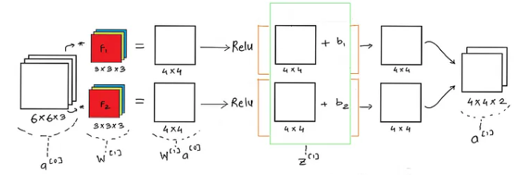

Slide 42

filter : 3x3x3
Stride : 1
Channel : 6
filter : 5x5x6
Stride : 1
Padding : 2
Channel : 12
filter : 3x3x8
Stride : 1
Channel : 24
28x28x3
Feature map size in every layer ?
FM = (N+2P-F)/S+1
How many weights and biases ?

Slide 43
How many weights and biases ?
1 neuron= multiple output

Slide 44
Pooling Layer in CNN
Down sampling
2 | 4 | 3 | 5
4 | 6 | 1 | 4
7 | 8 | 5 | 4
3 | 4 | 1 | 2
Pool size = (2,2)
Stride = 2
6 | 5
8 | 5
Max pooling

Slide 45
Pooling Layer in CNN
2 | 4 | 3 | 5
4 | 6 | 1 | 4
7 | 8 | 5 | 4
3 | 4 | 1 | 2
Pool size = (2,2)
Stride = 2
4 | 4.2
5.5 | 3
Average/Mean pooling

Slide 46
10 classes probability
4x4x12x128
26x26x6
13x13x6
9x9x12
4x4x12
128x10
28x28x1
Conv + Relu
Max pool
Conv + Relu
Max pool
Filter : 3x3
Channels : 6
Stride : 1
Filter : 2x2
Stride : 2
Filter : 5x5
Channels : 12
Stride : 1
Filter : 2x2
Stride : 2
Padding 1
Fully connected layer + Softmax
Fully connected layer + relu
Weights= 54 300 24567 1280 10 = 26211 (total)

Slide 47
How learning happens in CNN?
Forward propagation
Backpropagation

Slide 48
https://medium.com/advanced-deep-learning/cnn-operation-with-2-kernels-resulting-in-2-feature-mapsunderstanding-the-convolutional-filter-c4aad26cf32
https://stanford.edu/~shervine/teaching/cs-230/cheatsheet-convolutional-neural-networks
Backpropagation in CNN
https://www.jefkine.com/general/2016/09/05/backpropagation-in-convolutional-neural-networks/

